Slide 1
AGENTIC AUTOMATION • LANGGRAPH
Autonomous Recruiter Outreach & Job Hunter Agent
Cyclic state graphs for profile-matched role extraction, recruiter enrichment, and context-aware cold dispatches.

Slide 2
RECRUITING BOTTLENECK
Manual Pipeline Constraints
15h+
< 5%
0
Weekly manual parsing waste.
Generic template reply rate.
Persistent state across scrapers.

Slide 3
MULTI-AGENT EXECUTION
Cyclic Graph Architecture
Node 1: Job Scraper
Node 2: Resume Matcher
Node 3: Pitch Drafter
Targeted portal listings ingestion.
Graduation and skill alignment.
Contextual cold email generation.

Slide 4

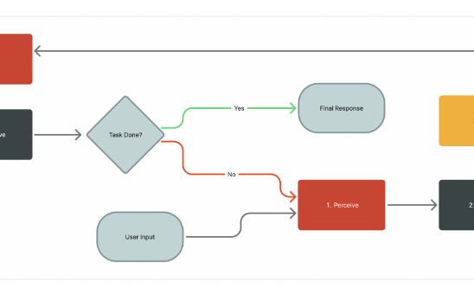
DATAFLOW GRAPH
Deterministic Fallbacks & Safeguards
Pydantic Validation: Zero hallucinated claims in email output.
Contact Enrichment: Resolves verified recruiter endpoints.
Cadence Scheduling: Automated 5-day human follow-up loop.

Slide 5
PIPELINE RESULTS
Operational Efficiency Multiplier
99.1%
Routing accuracy through cyclic LangGraph checkpoints
Zero Rate-Limit Drops: Async queue throttling
Conversion Rate: 4.2x above industry cold averages

Slide 6
STATEFUL REASONING SYSTEMS
Production Multi-Agent Systems
Transforming fragile manual scraping loops into deterministic, self-evaluating workflows.

Slide 7

Image Sources
https://blogs.oracle.com/developers/wp-content/uploads/sites/129/2026/03/Agent-Loop-%E2%80%94-Linear-Flow-with-Loop-back-scaled.png
Source: blogs.oracle.com

